Slide 1
KISANVAANI
VISHWAKARMA DEVS · KISAN ALERT WINNER
THE SOLUTION · ANY PHONE · LIVE TODAY
A farm advisor that works on any phone—
no app, no internet, no reading needed.
Built for small farmers on ordinary phones. Speaks their language. Warns before the crop is lost.
Extends government systems—does not replace them. Pilot path starts in Narasaraopet.
01
02
03
04
Call or text
Own language
Crop photo
Early warning
Dial or SMS shorthand.
Clear reply, same day.
12 languages. Detected
from speech—no menus.
One phone in the village.
Voice-note treatment back.
Dry spell / heavy rain—
alert only that block.
LIVE · kisan-vaani.vercel.app · Call / SMS +1 254 272 6372 · open source
14.6 cr
48% vs 16%
worse than 1:5,000
₹90,000 cr
operational holdings
advice source
farmers per officer
pest & disease loss / yr
86% small or marginal
dealers vs officers
51% posts vacant
ICAR: 20–40% avoidable
Sources: Agriculture Census 2015–16 · NSS-SAS · MANAGE/AESA · ICAR · NFHS-5 · product live links.
01 / 03
Notes:
0:00–0:50 · Krish Goyal, Team Vishwakarma Devs. KisanVaani — farm advisor on any phone. No app, no internet, no reading. Four things: call or text, own language, crop photo, early block warning. Numbers show why: 14.6 crore holdings, advice often from dealers not officers, extension stretched thin, huge avoidable crop loss. Live today. Extends government systems.

Slide 2
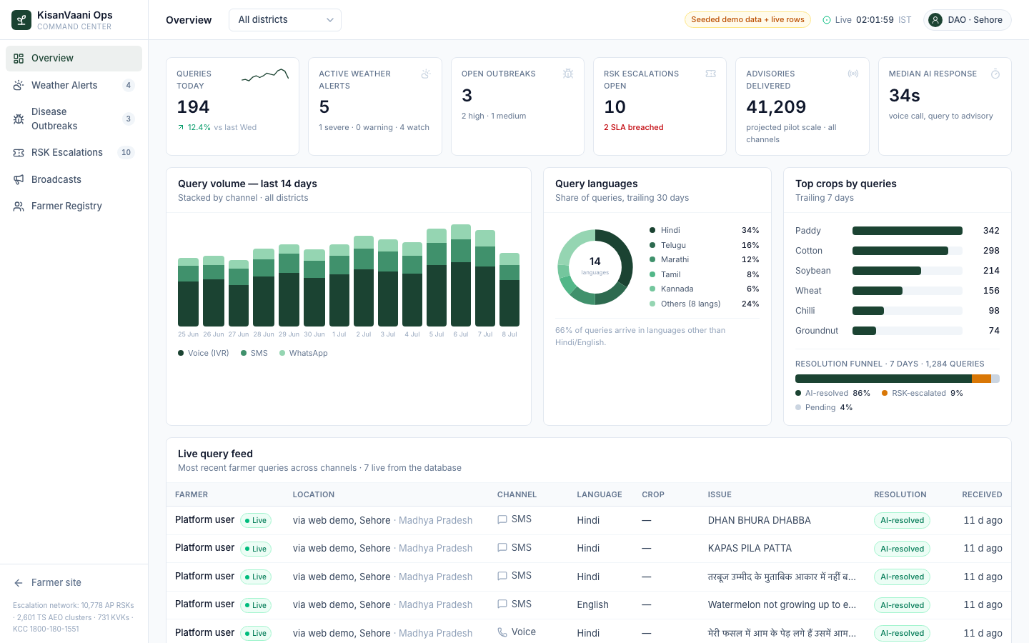
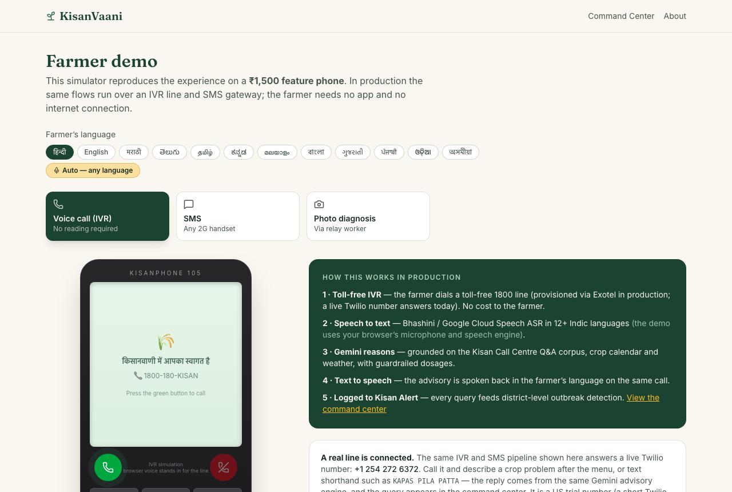
KISANVAANI
VISHWAKARMA DEVS · KISAN ALERT WINNER
WHAT WE BUILT · LIVE PROOF
Not a mock-up—a working system
you can call and open right now.
LIVE BUILD · 12 languages · voice / SMS / WhatsApp / photo · Soil Health Card · mandi · weather · +1 254 272 6372 · open source
01
ACCESS
02
GROUND
03
GUARD
04
LEARN
Any phone.
Own language.
Local evidence
before an answer.
Confidence and
risk gate.
A block-level
early warning.
Voice · SMS · WhatsApp · photo. No app or reading. Language from speech.
Soil Health Card · soil grids · weather · mandi prices · agronomy rules.
Clear case → next action. Low confidence → RSK / KVK handoff (48-hr target).
Clustered reports → officer review → alert only the affected block.
DISTRICT CONTROL ROOM · /command
FARMER PHONE EXPERIENCE · /demo · 12 languages
Try now: +1 254 272 6372 · kisan-vaani.vercel.app · github.com/frenchfryfeatures/kisan-vaani
02 / 03
Notes:
0:50–1:55 · Live system. Call +1 254 272 6372. [Telugu cotton yellow leaves.] Answers in Telugu. Four layers: access any phone, ground in local data, guard with expert handoff, learn for block alerts. Control room and farmer demo are real. Open source.

Slide 3
KISANVAANI
VISHWAKARMA DEVS · KISAN ALERT WINNER
IMPACT · PILOT DECISION
Low cost. Measured pilot.
Simple asks—no new scheme.
One mandal in Narasaraopet this rabi. Measure against control blocks. Scale only if the evidence holds.
< ₹12
≈ 25 : 1
₹5 lakh
+10–12%
per farmer / season
indicative return
pilot · two seasons
yield gain (field trials)
IVR ₹8 · SMS ₹1.2 · AI < ₹1
prevent 10% of ~₹6,164 avg loss
~20,000 farmers · one mandal
Avaaj Otalo, Gujarat · ACM
SCALE (two seasons, indicative) Pilot 20,000 farmers · ₹5 lakh cost · ≈₹1.2 cr value protected @10% → District ≈₹12 cr → 1 crore farmers ≈₹616 cr
TO PILOT WE NEED
WE DELIVER
WE MEASURE
01
Indian 1800 + SMS sender ID
01
Telugu-first voice / SMS onboarding
01
Time to useful advice
02
District review agenda slot
02
Local crop + data configuration
02
Alerts acted on in 48 hours
03
≈₹5 lakh for two seasons
03
Safety + expert escalation SOP
03
Crop value saved per rupee
04
Existing farmer IDs for signup
04
Officer dashboard (live today)
04
Expert SLA met
05
Green light to plug into KCC / NPSS
05
Endline evidence report
05
Published vs control blocks
THE PATH
Nominate the block.
Judge the evidence.
Narasaraopet mandal → district → KCC / NPSS integration
Field impact will be measured—not assumed from the demo.
Cost model at prevailing rates · ICAR loss base · Avaaj Otalo (ACM) · value protected is indicative @10% · scale only if evidence holds.
03 / 03
Notes:
1:55–3:00 · Under twelve rupees per farmer per season. About twenty-five to one if we prevent a tenth of average crop loss—conservative against Gujarat field trials. Pilot five lakh, two seasons, twenty thousand farmers, Narasaraopet this rabi. Five asks, no new scheme. We deliver onboarding, SOP, dashboard, evidence report. Measure against control blocks, publish either way. Nominate the block. Judge the evidence. Dhanyavaad.

